Slide 1
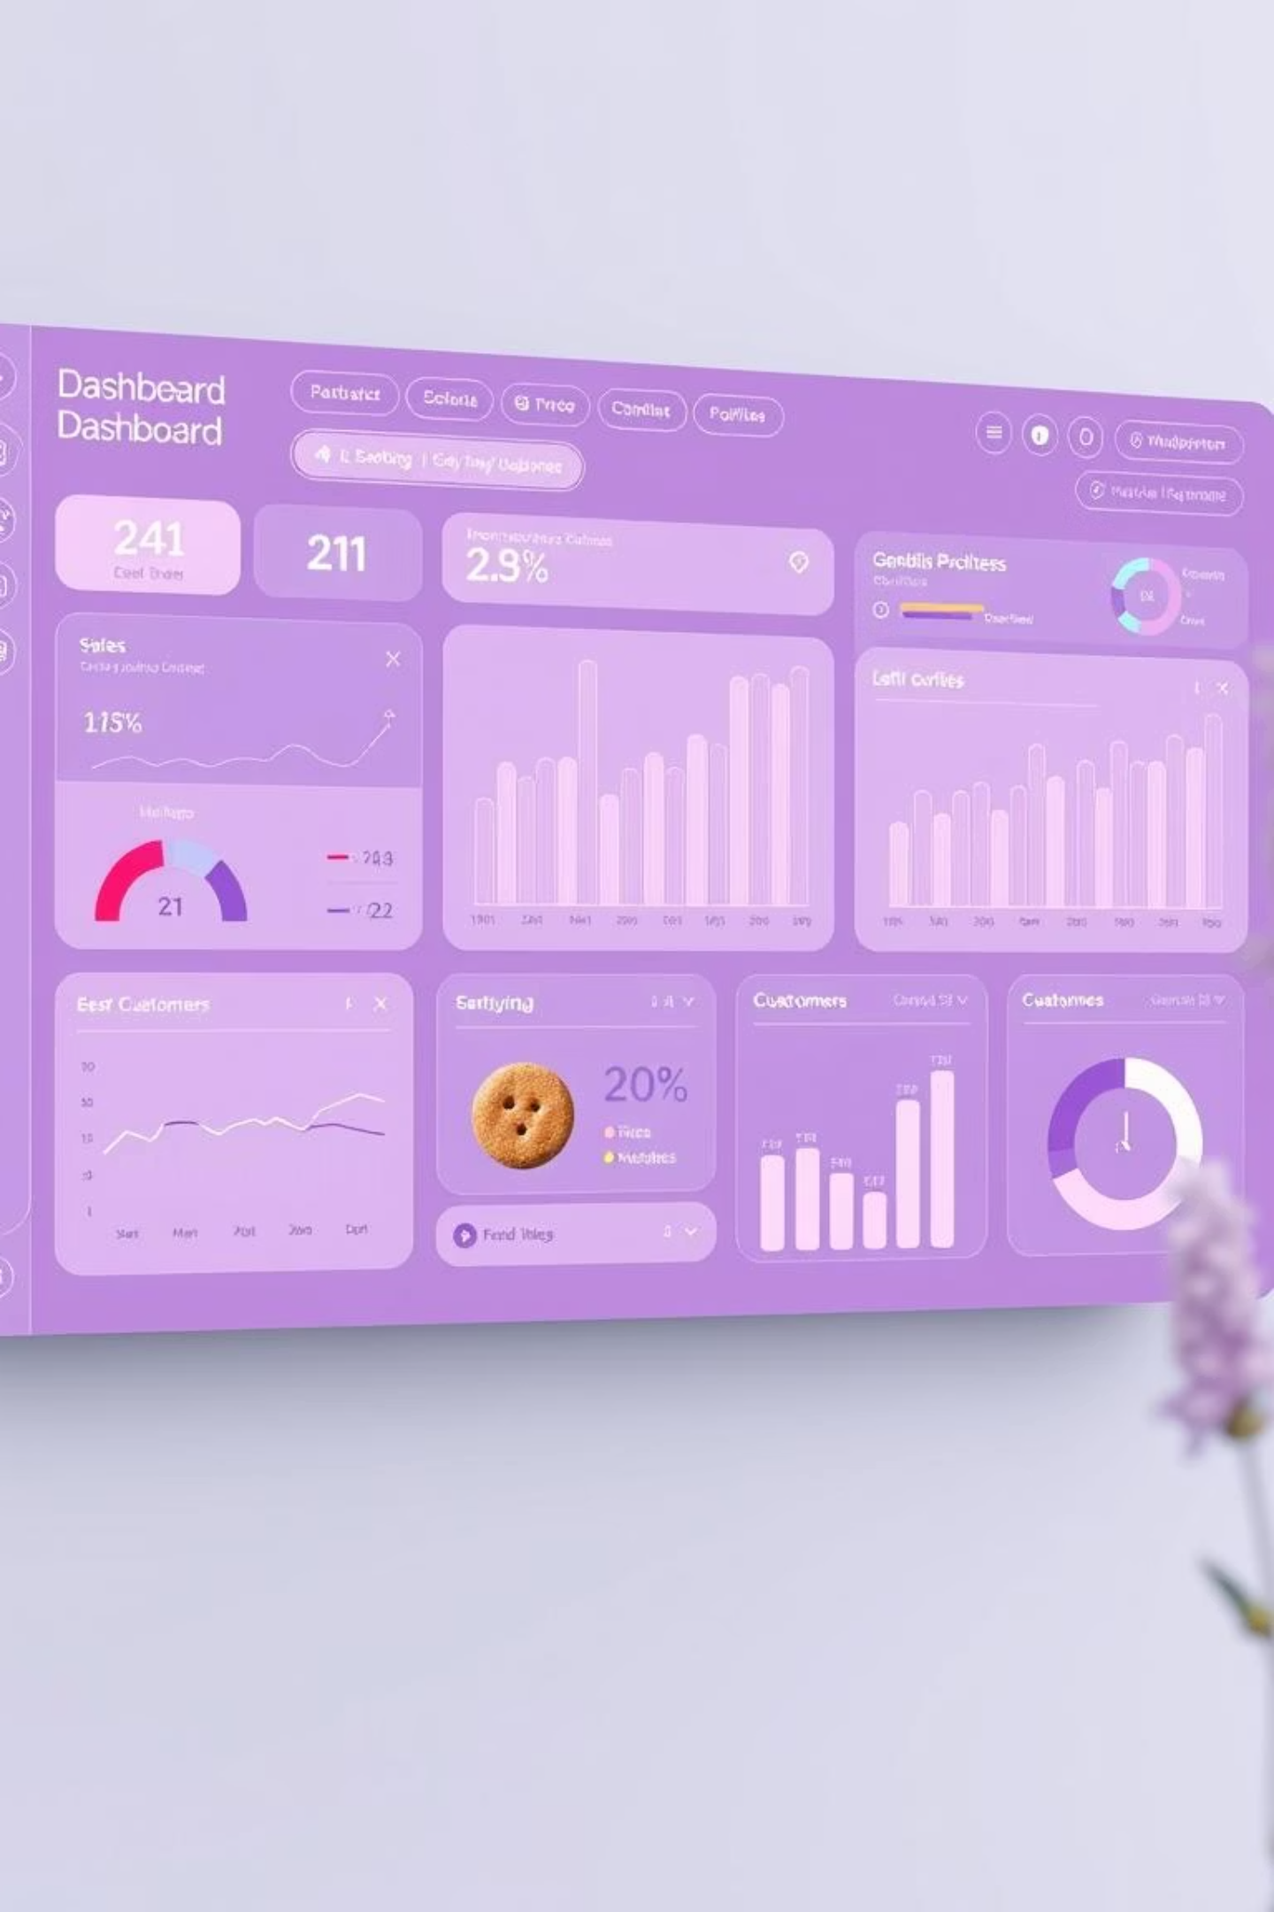

B&J Biscuit Business Analysis Dashboard
Join us as we explore sales, customers, and profitability for B&J Biscuit. We’ll uncover trends, top performers, and growth opportunities!
Rupnath Shaw
Data Analyst

Slide 2
Welcome to the B&J Biscuit Deep Dive!
1
2
3
Expertise
Focus
Mission
I’m skilled in Excel and learning dashboard creation, ready to turn data into useful insights.
My analysis is laser-focused on B&J Biscuit sales data, designed to reveal pivotal trends and performance drivers.
My goal is to empower B&J Biscuit to make faster, smarter, and more data-driven decisions that impact the bottom line.

Slide 3

Driving Growth: Our Core Objectives
📊 Project Goal
📈 Company Benefit
Our primary objective is to thoroughly understand revenue distribution, profitability drivers, and customer behavior patterns to optimize sales and marketing strategies.
By pinpointing top-performing products, high-potential locations, and key customer segments, we aim to significantly increase profit margins and expand market share.

Slide 4


Data Collection and Preparation
Data Source
Key Data Points
Calculated Fields
We utilized comprehensive internal B&J Biscuit sales data, ensuring direct relevance and accuracy for our analysis.
Transactions with product details, pricing, and cost of goods sold (COGS).
Total Revenue, Total COGS, and Net Profit.
Calculated Profit Margin and Price Category for deeper insights.
Customer demographics and sales location information.

Slide 5
Data Refinement: Ensuring Accuracy
Our data cleaning process in Excel was meticulous, ensuring the highest quality and reliability for our analysis.
01
02
03
Initial Refinement
Standardization
Categorization
Removed null values and irrelevant columns to streamline the dataset.
Standardized product names, location names, and age group labels for consistency.
Classified products into "Low" and "High" price categories to segment sales analysis.
04
05
Validation
Analysis Prep
Rigorous checks on calculations for revenue, cost, and profit to confirm accuracy.
Loaded the clean data into PivotTables, ready for in-depth analytical exploration.

Slide 6

Key Performance Indicators
Our analysis reveals strong performance across several critical metrics, highlighting significant sales volume and healthy profitability.
752,107
$15.2M
$6.6M
44%
Units Sold
Total Revenue
Total Profit
Profit Margin
This demonstrates our substantial market reach and customer demand.
A robust figure reflecting strong sales performance.
Indicating efficient operations and effective pricing strategies.
A healthy margin confirming the strong financial viability of our biscuit products.

Slide 7
Profitability: Key Drivers
Identifying the elements contributing most to our profit helps us focus future strategies.
🍪 Most Profitable Brand: Shortbread
📍 Most Profitable Location: San Antonio
👤 Most Profitable Customer: Robert Hernandez
Shortbread consistently leads in profit generation, underscoring its market appeal and strong margins.
San Antonio stands out as a high-yield market, ripe for further investment and expansion.
Understanding the profile of high-value customers like Robert Hernandez is crucial for targeted marketing.
🏆 Top Salesperson: Travis Doyle
👴 Most Profitable Age Group: 60–74 years
Travis Doyle's success provides a blueprint for best practices in sales strategy and customer engagement.
This demographic represents a significant opportunity for tailored product offerings and marketing efforts.

Slide 8
Revenue Distribution Snapshot
High Price
Low Price
By Price Category: High-priced products are the primary revenue drivers, indicating strong consumer willingness to pay for premium options.
By Age Group: The 45–59 and 30–44 age groups are our largest contributors, each providing approximately 24% of total revenue. The 60-74 age group is also a significant segment at 20%.
By Gender: Females account for a dominant ~84.5% of our total revenue, highlighting a key demographic for targeted marketing.
By Payment Method: Credit Card is the overwhelmingly preferred payment method within our analyzed dataset.

Slide 9
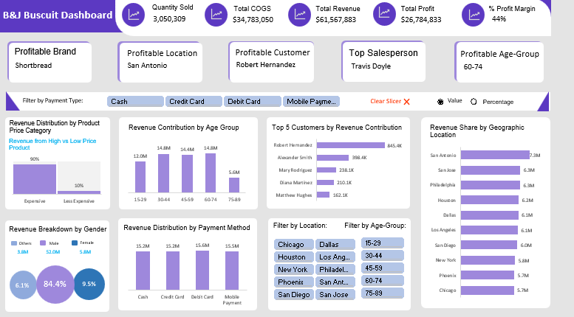
Interactive Dashboard

Slide 10
Actionable Recommendations for Growth
Based on our comprehensive analysis, we propose the following strategies to maximize B&J Biscuit's profitability and market presence.
Target High-Profit Demographics: Focus marketing campaigns on the 60–74 years age group, which shows the highest profitability.
Expand Geographic Reach: Intensify sales efforts and consider increased distribution in top-performing locations like San Antonio and San Diego.
Promote High-Margin Products: Prioritize the promotion and availability of Shortbread, our most profitable brand.
Leverage Payment Preferences: Design loyalty programs or exclusive offers tailored to customers using Credit Card, given its dominance.
Optimize Sales Training: Implement best practices from top performer Travis Doyle across the sales team to boost overall efficiency.

Slide 11
Thank You

